Slide 1
Reading Coffee Morning
Wednesday 22nd January 2020

Slide 2
Reading at Brentfield Primary School
To help our pupils be confident readers we start the reading process in Nursery with the teaching of phonics.
Phonics is taught at our school using the Read Write Inc programme for children in Nursery – Year 1.
You can find more information about this on the school website.
For pupils who don’t pass the phonics test at the end of Year 1 additional phonics sessions take place to ensure they have the key skills they need to help them be confident readers.

Slide 3
Reading at Brentfield Primary School
In addition to phonics we use the Daily Supported Reading programme in Reception (for pupils who are ready) to Year 2.
In year 3 to 6, we use the programme Destination Reader.
In these reading sessions, children read high quality texts and are exposed to new vocabulary. The books for these sessions are used at school.
More information can be found on the school website.

Slide 4
Changes we have made to reading
The library has changed to promote reading for pleasure.
We now have a new librarian and the library will be open to parents afterschool on Monday and Thursday each week.
The children can choose which book they would like to read and no longer need to test on books.
2. Children will be given book banded books which will be at the right reading level for the children.
Children will be assessed on reading using PM Benchmarks at the start of each term.
Their progress will be monitored in reading sessions and the children will move onto the next book band when they are ready.
3. We have spent over £15,000 on new books
For English lessons, the library and to bring home – please look after them. There will be a charge of £5 to replace lost books

Slide 5
Reading at Home
All pupils at Brentfield Primary School will be given books for them to practise their reading at home.
Year Group | Books they will bring home
Nursery | A book from the book corner which should be read to the children
Reception | A book from the library – you should read this story with the children. A phonics (RWI) book - they should be encouraged to read this themselves using their phonics. A levelled book – This will be given to children when they are ready - they should be encouraged to read this themselves but may need help with some harder words.
Year 1 | A book from the library – you should read this story with the children. A phonics (RWI) book - they should be encouraged to read this themselves using their phonics. A levelled book - they should be encouraged to read this themselves but may need help with some harder words.
Year 2 | A book from the library – you should read this story with the children. A phonics (RWI) book - This is only for children who failed their phonics test in year 1 - they should be encouraged to read this themselves using their phonics. A levelled book - they should be encouraged to read this themselves but may need help with some harder words.

Slide 6
Reading at Home
All pupils at Brentfield Primary School will be given books for them to practise their reading at home.
Year Group | Books they will bring home
Year 3 | A book from the library – you should read this story with the children. A levelled book - they should be encouraged to read this themselves but may need help with some harder words.
Year 4 | A book from the library – you should read this story with the children. A levelled book - they should be encouraged to read this themselves but may need help with some harder words.
Year 5 | A book from the library – you should read this story with the children. A levelled book - they should be encouraged to read this themselves but may need help with some harder words.
Year 6 | A book from the library – you should read this story with the children. A levelled book - they should be encouraged to read this themselves but may need help with some harder words.

Slide 7
What these books look like…
Read Write Inc Books
Read Write Inc Stages
With these books there are speed sounds for you to practise with the children as well as red and green words.
At the back of the book are questions for you to ask your child to check they have understood the story.

Slide 8
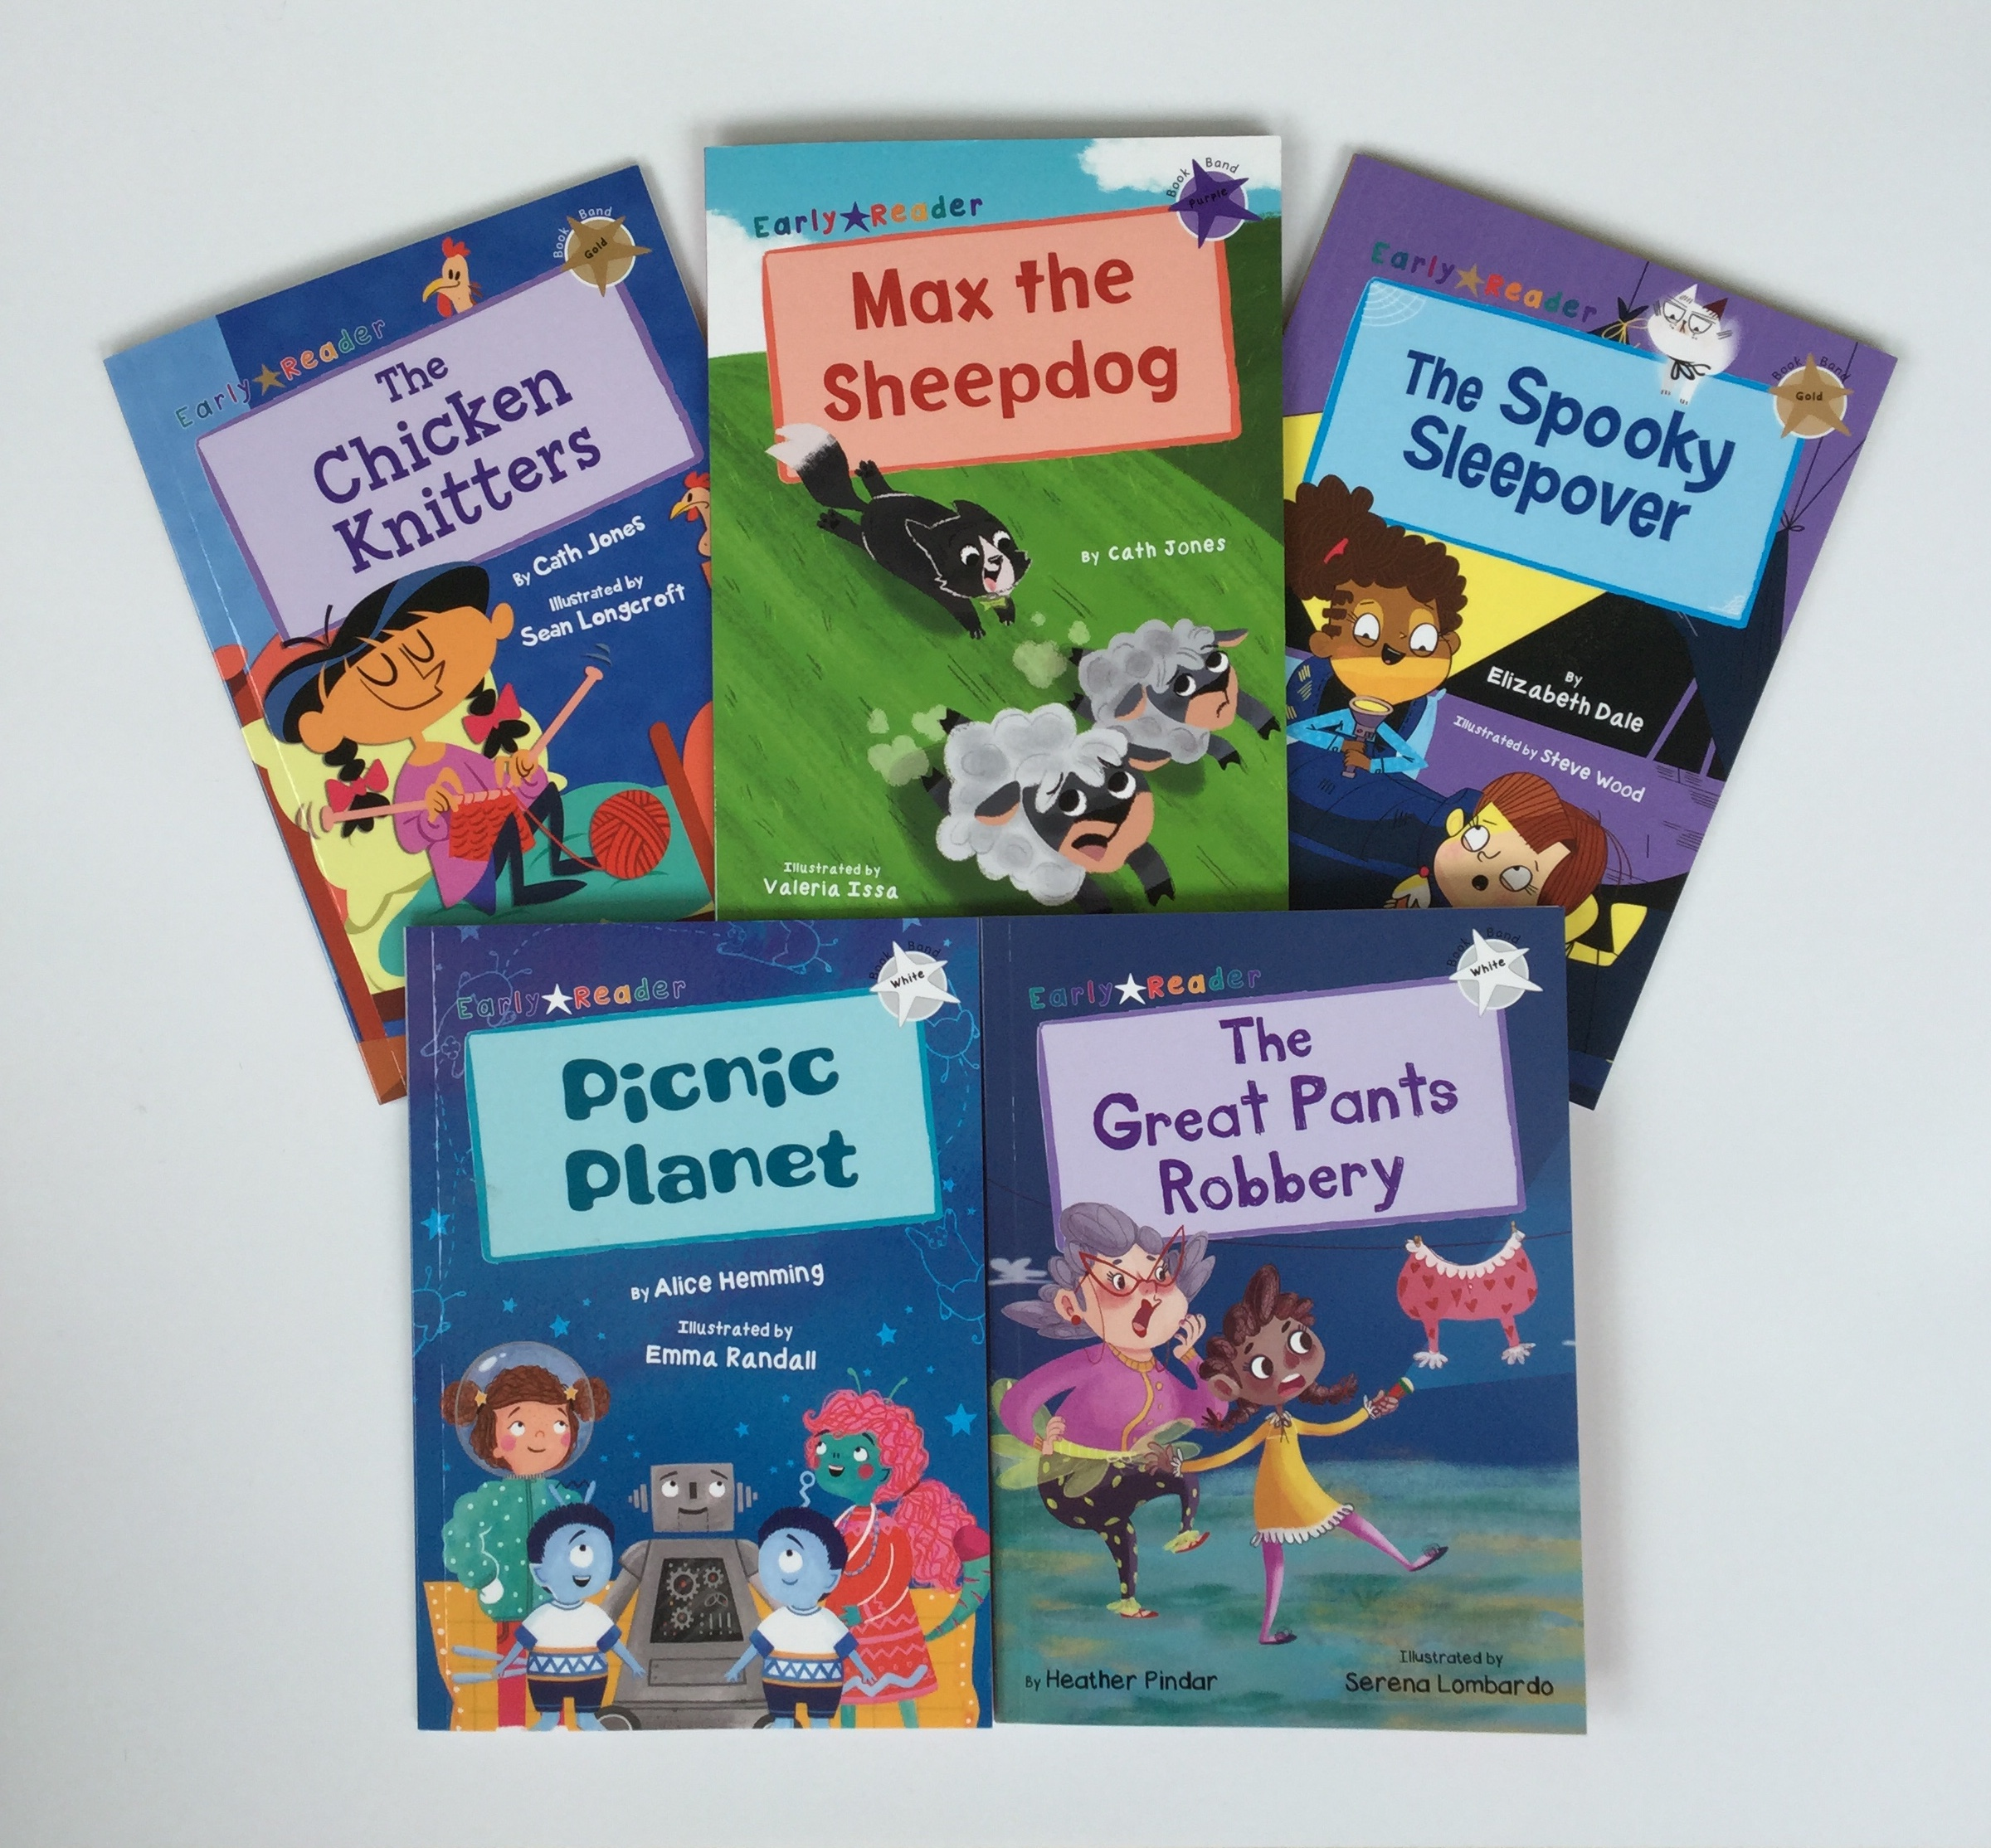
What these books look like…
Book Band Stages
Levelled books…
These books will either have a sticker or the information somewhere on the front of the book.
These books also have questions for you to ask about the book, especially for the lower levels.

Slide 9
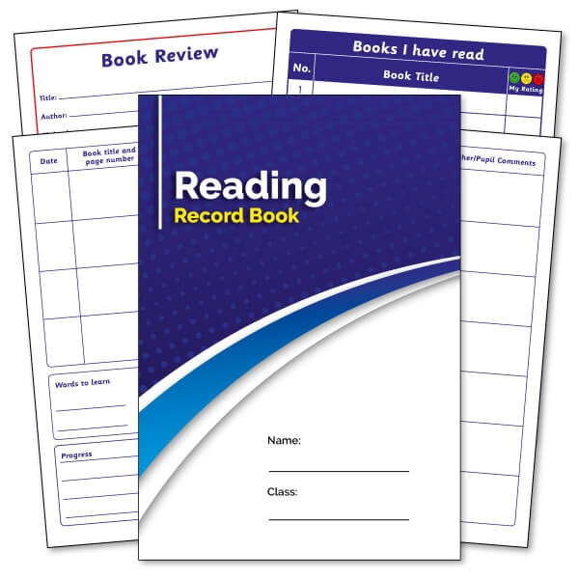
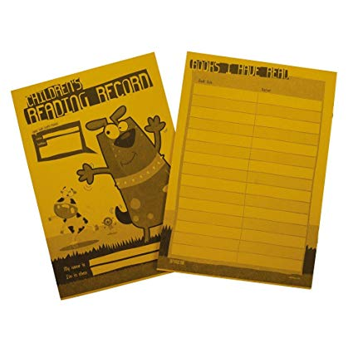
Brentfield Primary School Home Reading
Reading records –
Reception – Year 6
Please make sure all books including the reading record are brought in daily.
Book Band/Levelled books – Reception – Year 6
Library Books
All pupils
Read Write Inc books – Reception – Year 2
Read Write Inc Books –
Reception – Year 2

Slide 10
Filling in Reading Records
The reading record book is a way for you
to record the reading that happens at home.
You should listen to your children reading for between 10 – 20 minutes everyday!
On the next page is an example of how you should fill it in.

Slide 11
Filling in Reading Records

Slide 12
Example comments

Slide 13
Questions

