Slide 1
Phonics Workshop
Wednesday 20th March 2019

Slide 2
Aims of the session
What is phonics?
How phonics is taught at Brentfield Primary School?
What is the Phonics Screening Test?
How you can help at home?

Slide 3
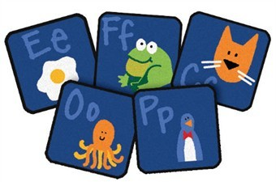
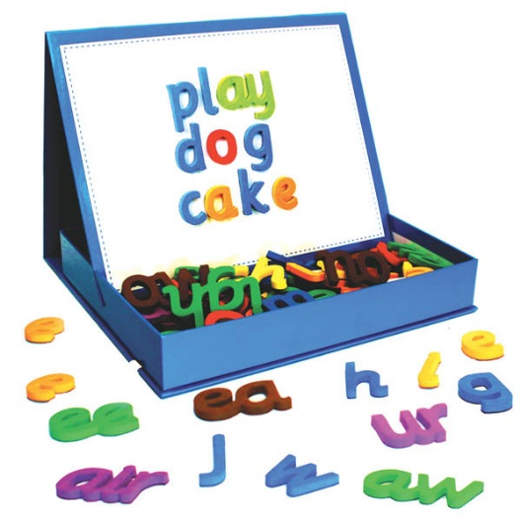
What is Phonics?
Phonics is the process of teaching children to read.
In phonics children are taught the grapheme-phoneme representations for the 19 letters of the alphabet to begin with. They then go on to learn all 44 phonemes (sounds) in the English language.

Slide 4
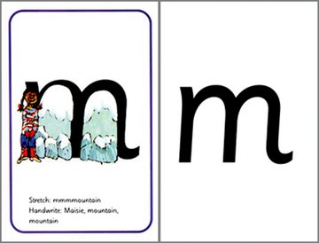
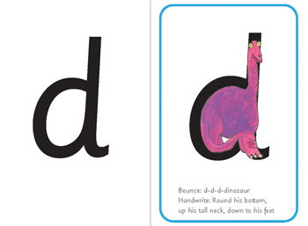
What do these words mean?
grapheme – Written letters, or a group of letters. Children will learn what the letters look like.
In Read Write Inc, children are taught rhymes to help them write the letters (graphemes).

Slide 6
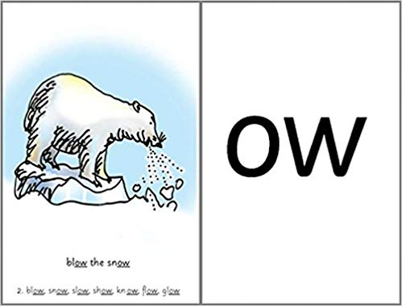
What do these words mean?
phoneme – A single sound that can be made by one or more letters, e.g. s, k, oo, ph or igh.
In RWI, children learn the sound and for Set 2 and 3 say a rhyme to help them remember the word.

Slide 8
Once children have learnt these, they will then apply this knowledge to help them read words by:
Blending - Saying the individual sounds that make up a word and then blending the sounds together to say the word.
Segmenting - Splitting a word up into individual sounds

Slide 9
How is phonics taught?
At Brentfield Primary School we use Read Write Inc Phonics to teach the children phonics.
What is Read Write Inc Phonics?
Read Write Inc (RWI) is a phonics based programme which helps children learn to read whilst also developing a wide range of vocabulary and encouraging a love of stories.

Slide 11
By the end of Year 1, children should have learnt all 44 sounds which means they should be able to read any word.
It is important that they are able to recognise all 44 sounds because sometimes, there is more than one way to say a sound.
Example:
f ff ph All make the same sound.

Slide 13
How to read words (segmenting and blending)

Slide 14
Let’s practise using some phonics to read the words below:

Slide 15
What is the Phonics Screening Test?

Slide 16
The phonics screening check is designed to see if children have learnt enough phonics decoding and blending skills needed to be successful readers.

Slide 18
In the test the children will read some non-sense words. These are words that are not real and have no meaning.
It is designed to see if children can read new words they have not seen before.
When reading these words it is important that children do not try to read the word but use their phonics to sound out the words.
They will know it is a nonsense word because it will have a picture of an alien. Please encourage your children to take their time when reading these words.

Slide 19
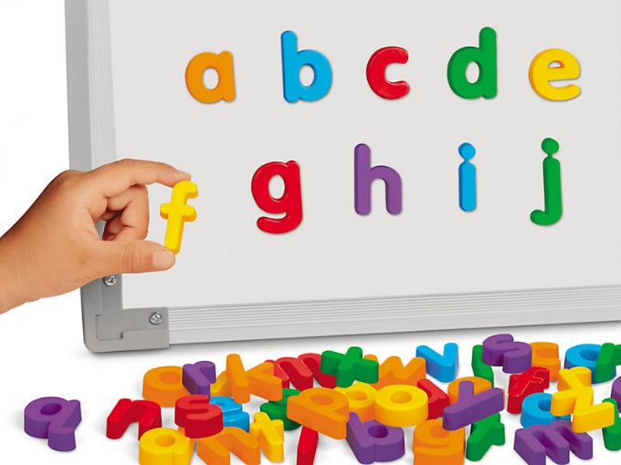
How can you help at home?

Slide 20
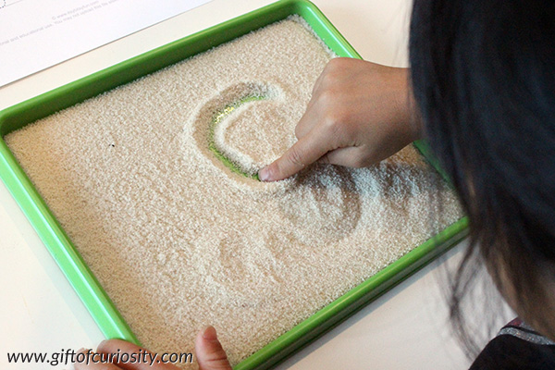

Slide 21
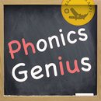
Phonics Apps
Oz Phonics
Alphabet Sound Word Study
The Joy of Reading
Read with phonics
Phonics Genius

Slide 22
Useful websites:
https://www.phonicsplay.co.uk/Phase2Menu.htm
https://www.topmarks.co.uk/english-games/5-7-years/letters-and-sounds
http://www.familylearning.org.uk/phonics_games.html

Slide 24
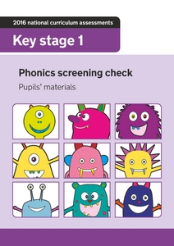
Practice the phonics screening test at home using resources given by the Year 1 teachers!

Slide 25
Questions?

